Slide 1

Evolutionary algorith for the Game of Nim
Alessandro De Marco - 317626

Slide 2

Best strategies
Key Concept: The winning strategy for Nim revolves around the concept of "Nim Sum", calculated using the bitwise XOR operation.
Nim Sum Calculation: Convert the number of items in each pile to binary, and then perform a bitwise XOR (exclusive or) operation across all piles.
Winning Move:
If the Nim Sum is zero, your position is currently losing, and any move will leave a winning position for the opponent unless they make a mistake.
If the Nim Sum is non-zero, make a move that results in a new state where the Nim Sum is zero. This is always possible if the Nim Sum is non-zero.

Slide 3

Genome definition
The genome is made of 2 parts: target_preference e target_range.
The target_preference in the genome represents an individual's tendency to aim for a specific nim_sum value after making a move, expressed as a random float between 0 and 1
The target_range in the genome defines the proportion of the total nim_sum range that an individual is willing to consider as acceptable for making a move, with the value being a float between 0 and 1 to represent the size of this acceptable subset relative to the game's full range of nim_sum possibilities.

Slide 4

Target Preference
0
N
Nim sum range
0
0.4
1
I.e. target preference = 0.4

Slide 5
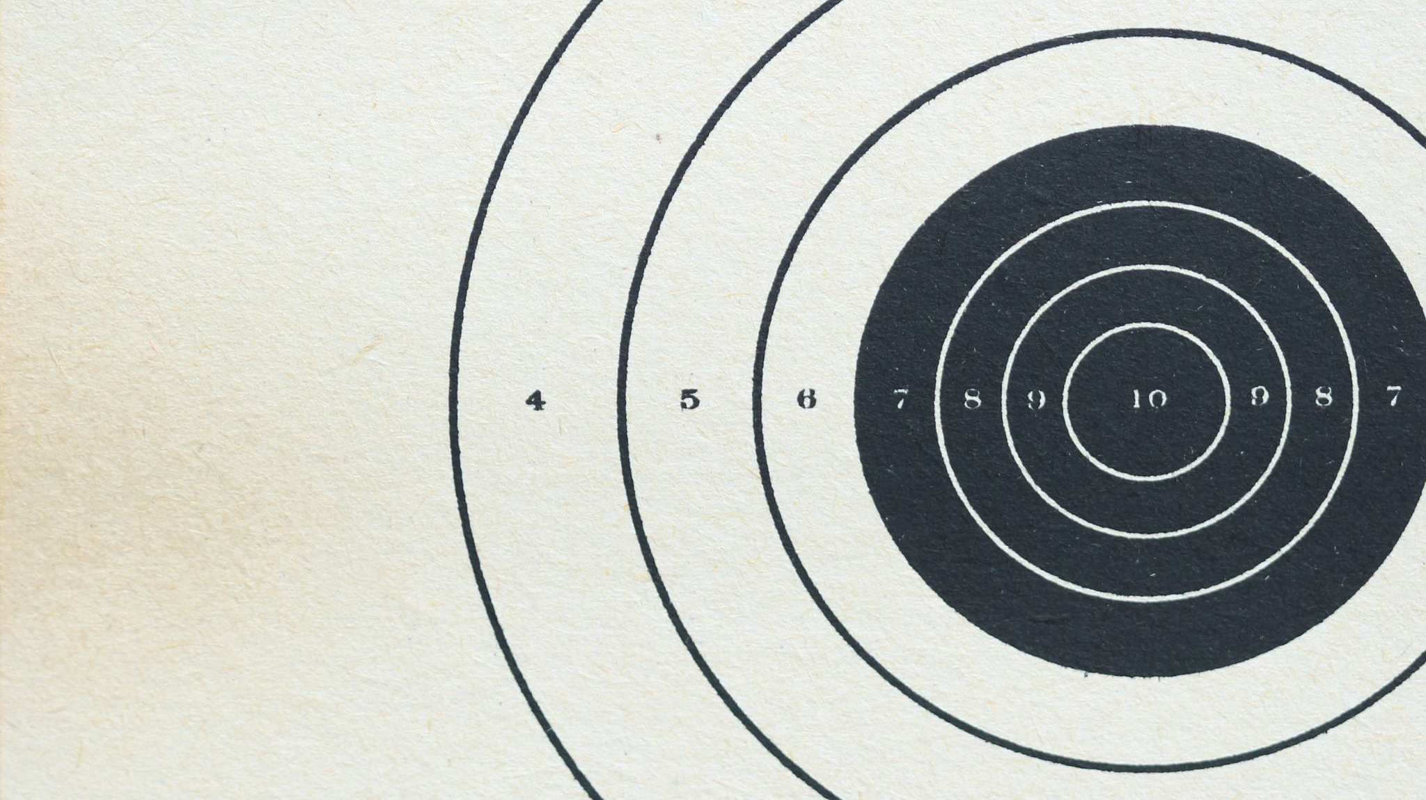
Target range
I.e. target preference = 0.4
0
0.3
0.4
0.5
1
I.e. target range = 0.2

Slide 6
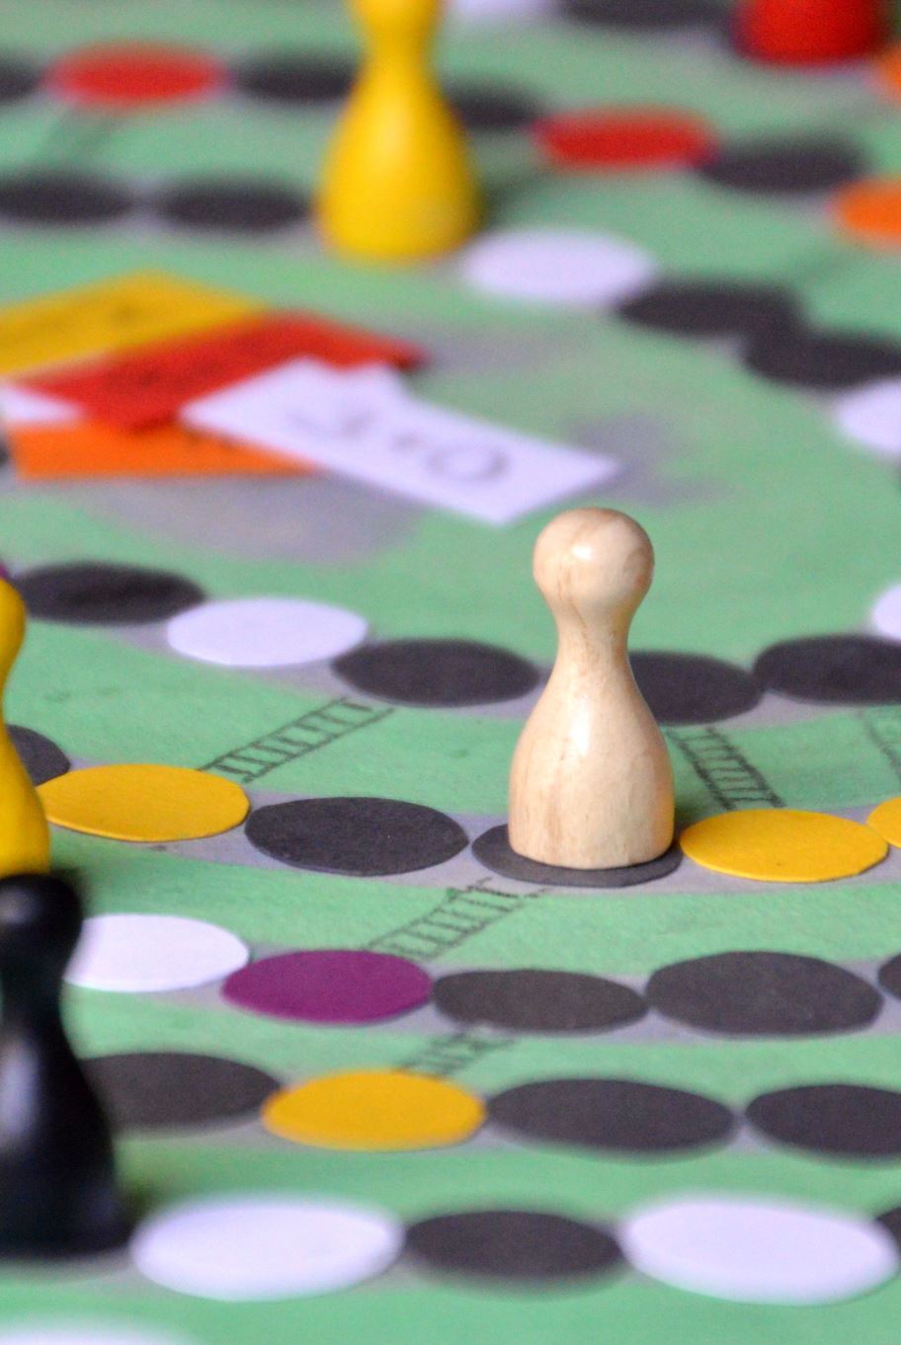
Parent selection
Two selection methods were implemented and compared
Roulette Wheel Selection
Tournament Selection

Slide 7
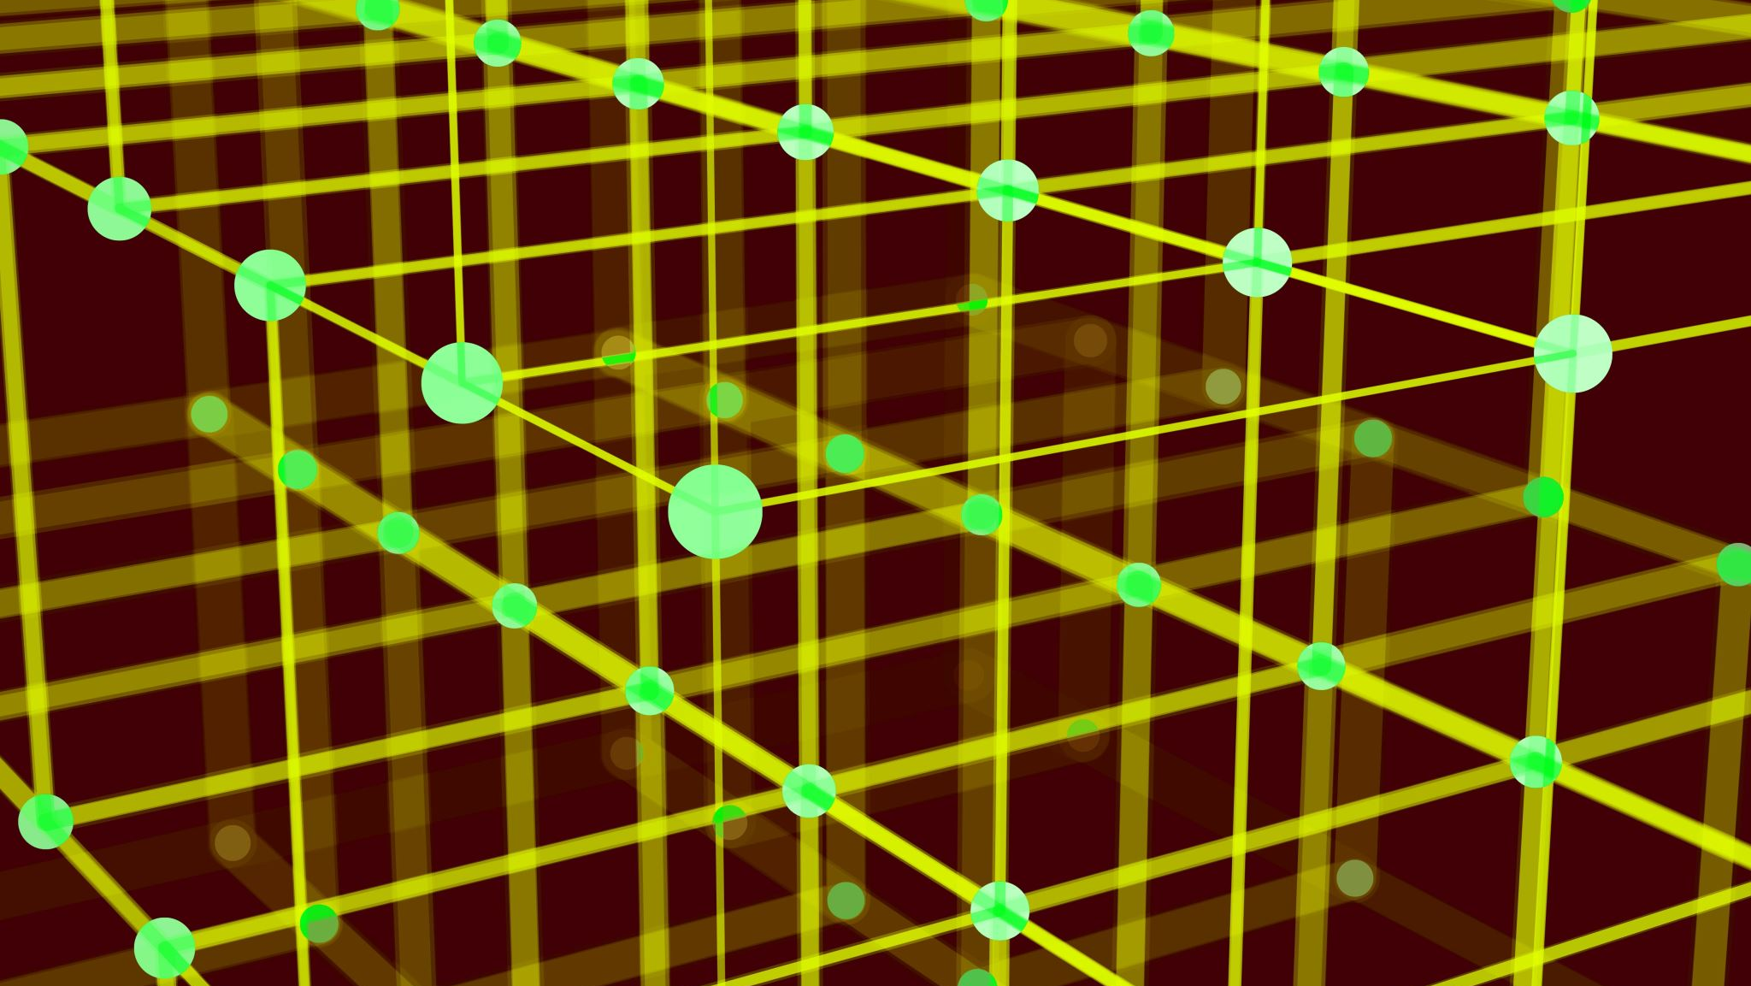
Simulation
10 Epochs: Represents the total number of generations the simulation will run through. Each epoch sees the creation of a new generation of individuals.
25 Number of Games per Individual: Indicates the number of games each individual in the population will play. It's crucial for determining the fitness of each individual.
Population (200): The total number of individuals in each generation. A larger population size allows for more genetic diversity.
100 Parents :The number of individuals selected as parents to create the next generation. This selection is key to passing successful traits forward.
Tournament Size (50): Used in tournament selection method. It's the size of the group from which one parent is selected based on fitness.
Mutation Rate (0.1) : The probability of a random mutation occurring in an individual's genome. Mutation introduces new genetic variations into the population.

Slide 8

Result

Slide 9
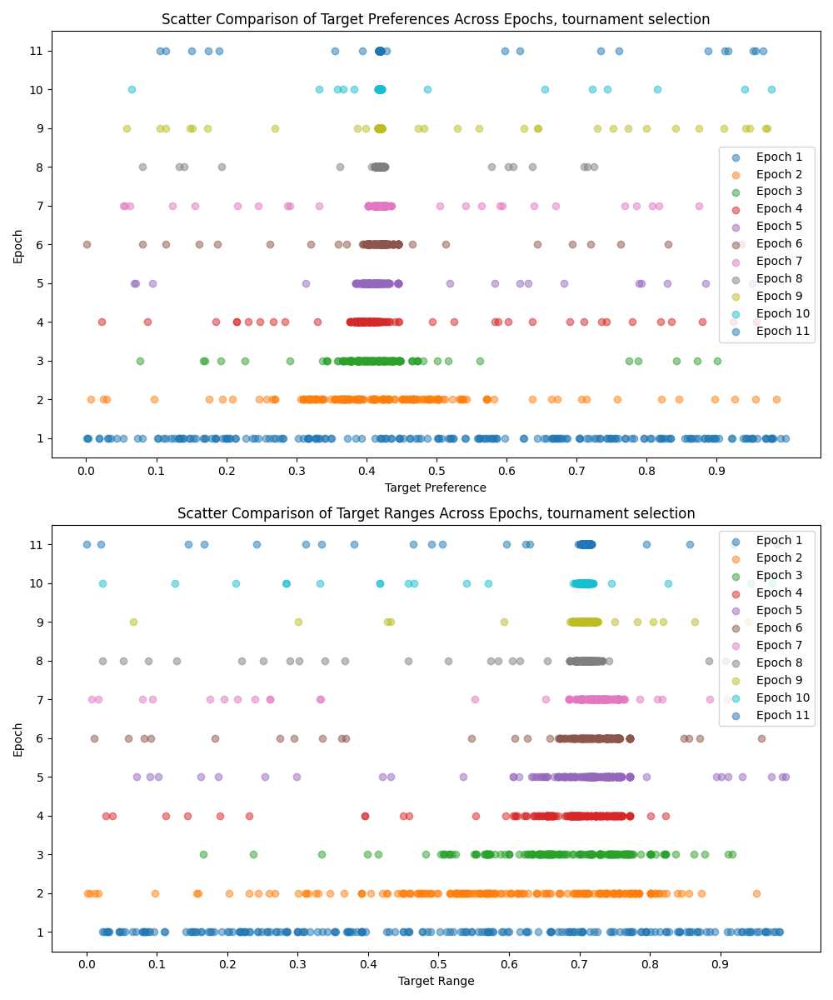
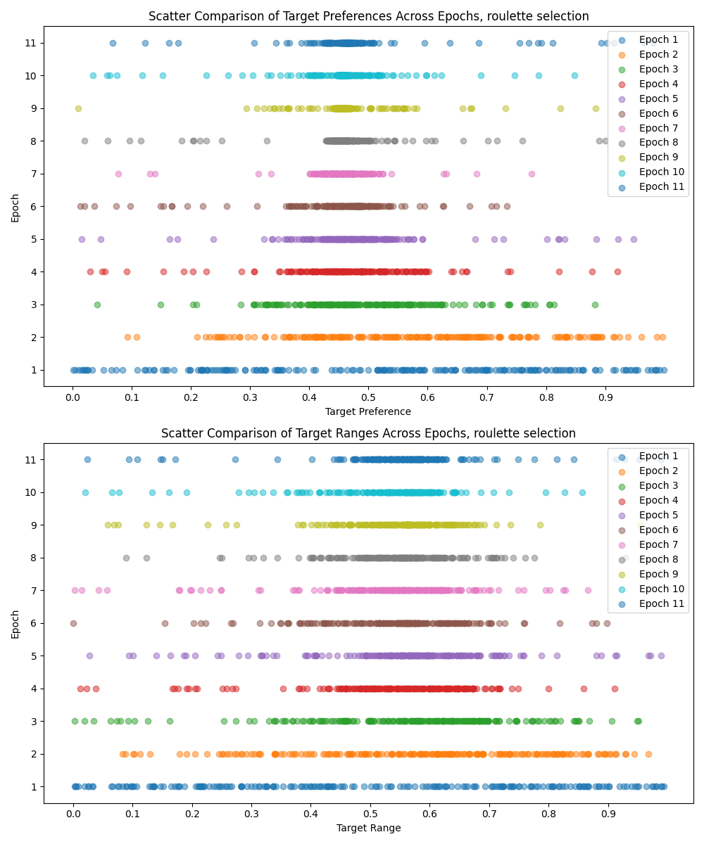
Tournament selection
Roulette wheel selection

Slide 10
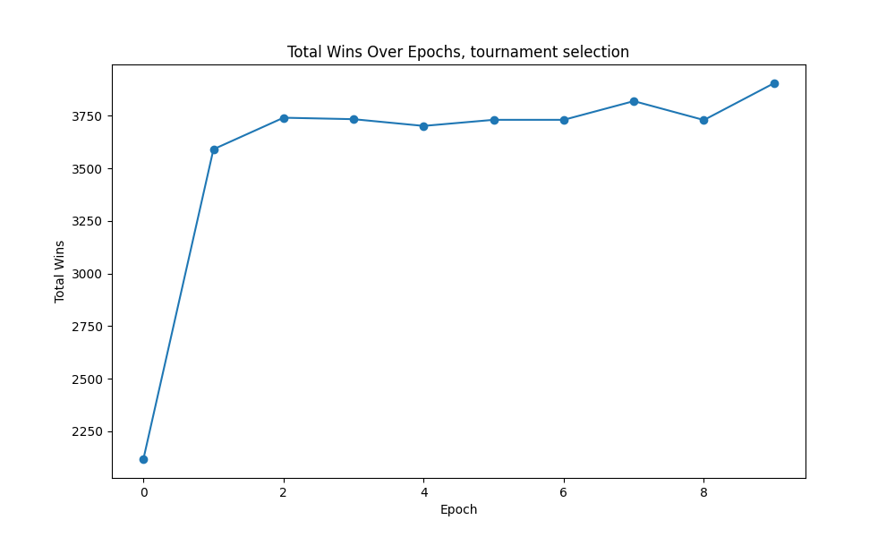
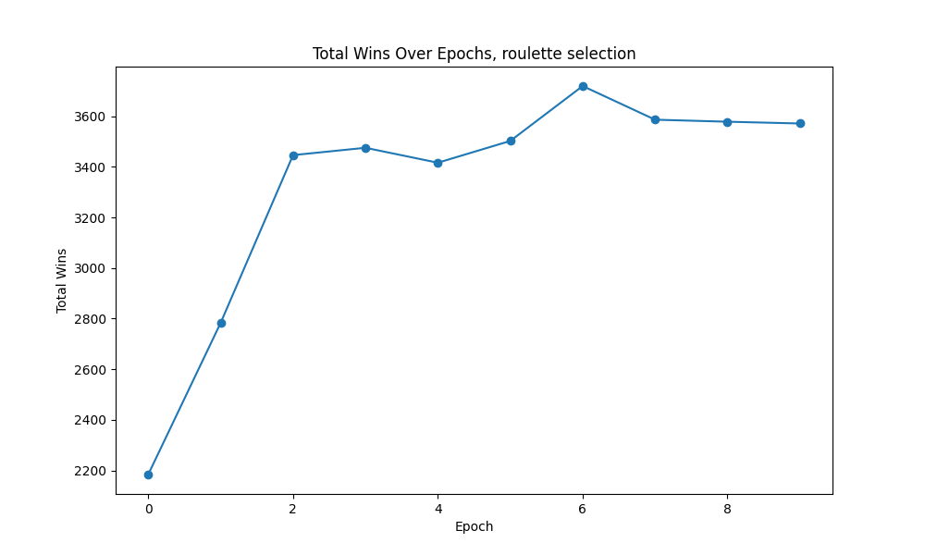
Tournament selection
Roulette wheel selection

Slide 11
Tournament selection
Roulette wheel selection

Slide 12
Thanks for the attention
Alessandro De Marco - 317626 – github: Aleedm

